Slide 1




Mental Health Awareness Week
Stress! Triggers, Effects, Aids & Solutions
With
Miriam Rooney, Chief of Staff & Client Director, Armstrong Wolfe
Ama Afrifa-Tchie, Head of People, Wellbeing & Equity, Mental Health First Aid England

Slide 2
Coming Up on Mental Health Awareness Week…
11th May 15:00-16:00 BST, WCOOC presents;
Managing the wellbeing of staff for better productivity and retention
12th May 12:00-13:00 BST ,
How to support and retain engagement when 2nd and 3rd degrees of contact are lost?
13th May 10:00-11:00 BST ,
Mental Health and Wellbeing with keynote, TedX speaker and Mental Health Campaigner Geoff McDonald
14th May 12:00-13:00 BST ,
Leading with Authenticity and Compassion

Slide 3


Managing stress in the workplace
© MHFA England 2021

Slide 4








MHFA England
  MHFA England
Delivering for 15 years
Globally recognised training provider
Working with over 20,000 employers
Evidence based training
Average increase in confidence post training 69.4 %
2,000+ qualified Instructor Members in England
Over 550,000
individuals trained in England
Mission: to train 1 in 10
Notes:
As a Social Enterprise, our Vision is to Improve the Mental Health of the Nation, by Training 1-in-10 in Mental Health Awareness & Skills
We are the Experts in Workplace Mental Health – we have worked with over 20k organisations and trained over 0.5m people in England
Evidence-based: Our courses are grounded in research & rigorously tested – developed with clinical experts & people with lived experience of mental health issues

Slide 5

MHFA England
  Agenda
1 | Sources of stress
2 | Address your stress – the stress container
3 | Habits and routine
4 | Boundaries
5 | Connection
6 | Resources for you and your team
7 | Useful links
8 | Questions and Answers
Notes:
*talk through slide*

Slide 6
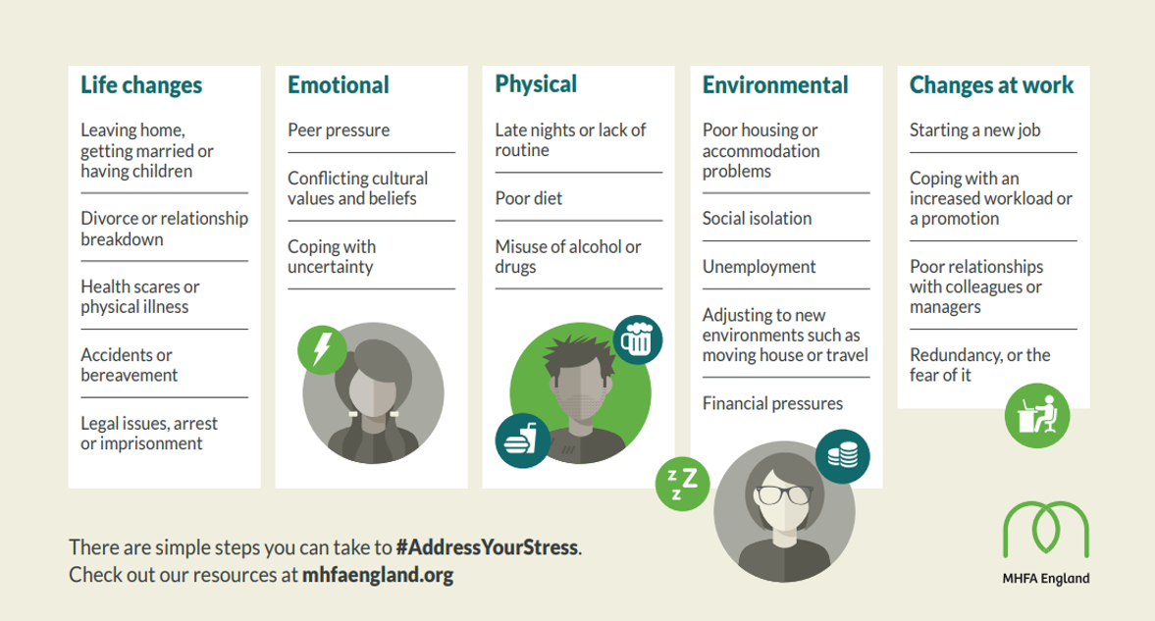
MHFA England
  Sources of stress
Notes:
When we talk about stress, it’s important to identify and remember the sources of stress that can affect us in the workplace.
The key thing to note here is that not all stress that we bring to the workplace is necessarily about work!
Over the course of the next half an hour or so we will explore the ways in which we can support our selves and our colleagues to manage and mitigate the effects of stress so that we can thrive in our roles.

Slide 7
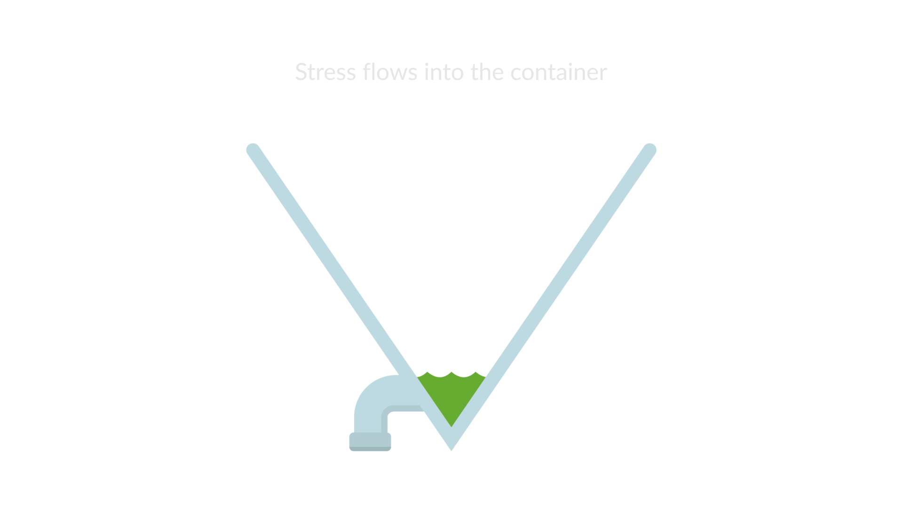
MHFA England
  The stress container
Notes:
Key Messages:
We all have a limit or capacity of how much stress we can contain before we will move from wellness to illness, and that limit is unique to everyone.
Our level of vulnerability is determined by a number of factors: genetics and exposure to protective life experiences or adverse life experiences as we grow up.
If we are to stay healthy then we need to become stress vigilant and spot signs that we are moving past the line. How effective are our coping strategies?

Slide 8

Address your stress

Slide 9

MHFA England
  Habits and routine
Having a regular routine whether in the office or at home can help you:
Lower stress levels
Form good daily habits
Take better care of your health
Help you feel more productive
Help you feel more focused
Notes:
Even if you don't typically thrive on a strict schedule, having a routine can be helpful in times of unpredictability, uncertainty, and stress.
Implementing a structure to your day can give you a sense of control. It can also improve your focus, organization, and productivity.
Having a routine is about more than just your day-to-day responsibilities and your work— don't forget to make time for self-care.
To maintain a sense of unity and openness, senior leaders should role model healthy working from home habits and behaviours.
Many of us perhaps thought that working from home would be a short-term experience, so have not really considered how our habits may be affecting our long-term physical and mental health.

Slide 10
MHFA England
  Boundaries
Tips for communicating boundaries:
Use clear, specific and non-judgmental language
Focus on what you want or need from a situation
Remember to empathise, hear and verbally reflect back the other’s needs and feelings
“Boundaries are a part of self-care. They are healthy, normal, and necessary.”

Slide 11

MHFA England
  Connection
According to Action for Happiness strengthening our relationships and building connections is essential for our happiness:
People with strong and broad social relationships are happier, healthier and live longer
Close relationships with family and friends provide love, meaning, support and increase our feelings of self worth
Broader networks bring a sense of belonging
Notes:
It is vital we deepen our connections with colleagues, friends, and community
Make sure you keep communication open with your team, as often and frequently as possible.
Making the time to socialise with people from across the organisation can help people see the bigger picture, stay connected, and boost morale. You could arrange coffee mornings, a Friday ‘happy hour’, or try a new activity.

Slide 12

MHFA England
  Wellbeing before work
Tips for 1:1 conversations (both virtual and in person):
Always start by discussing how people are feeling before talking about workloads
Be present, eliminate distractions, and actively listen as if you were physically together
Keep your language open and empathetic
Not every conversation has to be a video call (for virtual settings)
Remember where further support can be accessed
Notes:
*talk through slide*

Slide 13
Resources and exercises for you and your teams

Slide 14
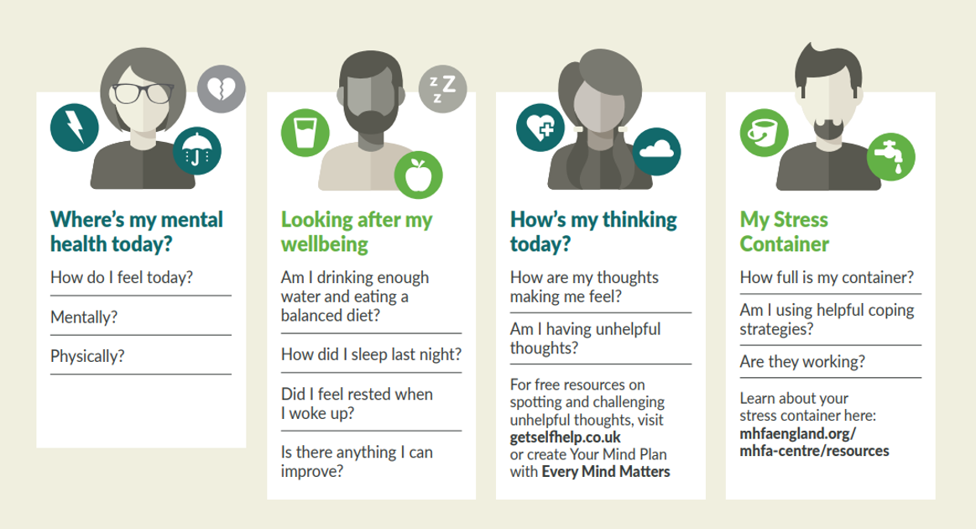
MHFA England
  Weekly wellbeing check up
Notes:
The weekly wellbeing check-up provides some useful questions to ask yourself about your wellbeing, and to provide some areas of conversation with those you are supporting.
Weekly wellbeing check up is a great tool and a great way to make sure you’re looking after your wellbeing to make sure you continue to thrive!

Slide 15
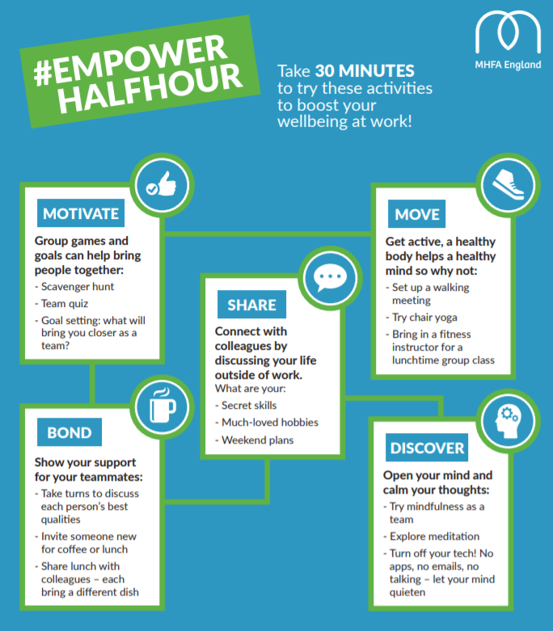
MHFA England
  Empower half hour
30-minute activities to boost your wellbeing during the workday
Notes:
*talk through slide*

Slide 16
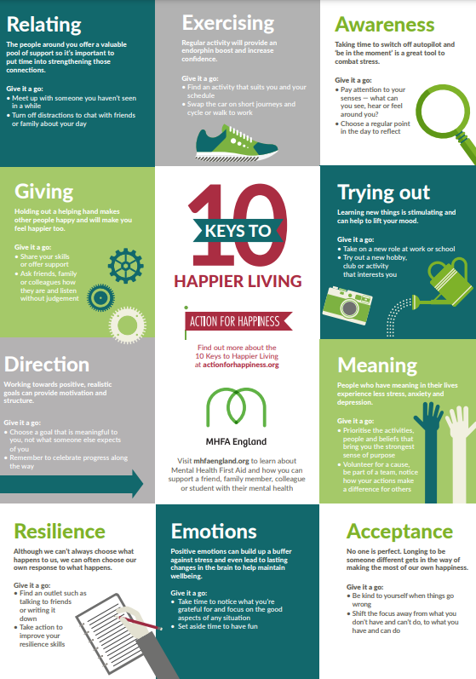
MHFA England
  10 Keys to Happier Living
Everyone’s path to happiness is different, but evidence suggests that these 10 Keys consistently tend to have a positive impact on wellbeing
Notes:
Created by MHFA England in partnership with Action for Happiness.
The Ten Keys to Happier Living are based on a review of the latest research from psychology and related fields.
The first five keys GREAT (Giving, Relating, Exercising, Awareness and Trying Out) are about how we interact with the outside world in our daily activities. They are based on the Five Ways to Wellbeing developed by nef as part of the Foresight Project.
The second five keys DREAM (Direction, Resilience, Emotions, Acceptance and Meaning) come from inside us and depend on our attitude to life.

Slide 18



  About My Whole Self
Why?​
Wherever you are working from, feeling supported to choose to bring your whole self to work is better for wellbeing and better for business. The highest performing workplaces are supportive and inclusive.
‘Psychological safety’ is one of the 5 key elements that makes for a high performing team (Google’s Project Aristotle). This occurs when a team feels safe enough to take risks and be vulnerable with one another.
Doing so enables people to focus on the job in hand, supports mental health and wellbeing, and boosts productivity through innovation.
Notes:
What?​
Celebrate My Whole Self Day on March 18!
Start creating a workplace culture where everyone can bring their ‘whole self’ to work. ​
Put diversity and inclusion at the centre of workplace mental health and wellbeing​.
Go beyond awareness to deliver action through events, advocacy and uptake of practical resources​.
18

Slide 19
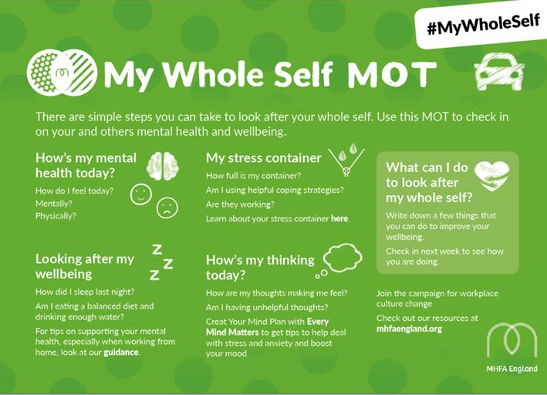
  The My Whole Self MOT
Download more information including the My Whole Self toolkit: www.mhfaengland.org/my-whole-self
19
Notes:
Regular wellbeing check-ins with colleagues are a vital way to support people’s mental health during the pandemic.
MHFA England has launched the My Whole Self MOT – a simple, free guide to enable people to regularly check in on their mental health.
19

Slide 20

  Racism and mental health
Racism and mental health
Many People of Colour and Black people say they have to hide parts of their identity at work:
The highest performing workplaces are supportive and inclusive
Feeling comfortable to be your ‘whole self’ at work is better for mental health and better for business
My Whole Self resources can help employers to become actively anti-racist and support the mental health of People of Colour and Black colleagues
Leaders and managers should be role model anti-racist behaviours
20
Notes:
- It’s important to remember that the highest performing workplaces are supportive and inclusive, with healthier working cultures built on respect and collaboration.
​
- Many People of Colour and Black people say they have to hide parts of their identity at work. The My Whole Self campaign is calling on employers to become actively anti-racist.
20

Slide 21
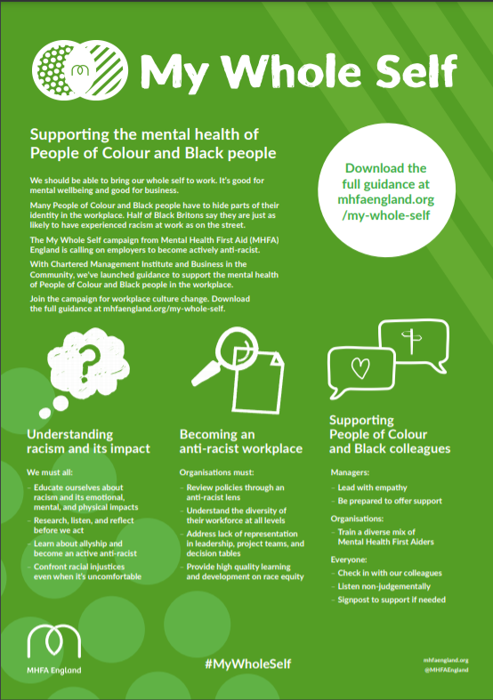
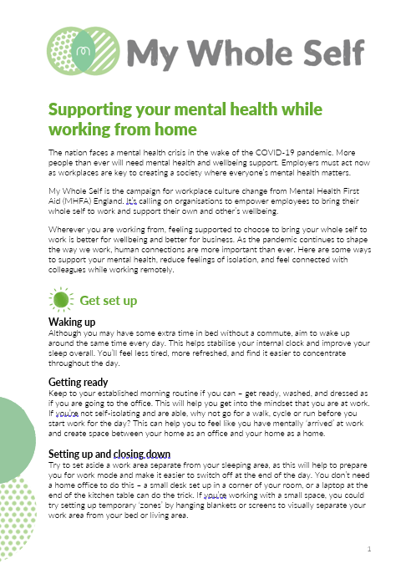
  Guides for your teams
Other self care toolkits: https://mhfaengland.org/my-whole-self/anti-racist/
21
Notes:
21

Slide 22
MHFA England
  Useful links to resources
My Whole Self Campaign resources for Workplaces
10 Reasons for Employers to Invest in Staff Mental Health
MHFA England Information Pack for Workplaces
Implementing Mental Health First Aiders: Guide for Employers
Understanding Stress: What’s in Your Container?
10 Keys to Happier Living
Triggers and signs of mental ill health
Take 10 Together
Line Manager’s Resource
Workplace Wellbeing Toolkit
Mental Health resources for remote working
Notes:
Lots of Resources on our website – for Individuals (e.g. Addressing Your Stress, Remote Working) – for wider Awareness & reducing stigma – for Schools, Universities, Workplaces & Communities – to support our Campaigns (e.g. Bring #MyWholeSelf to work)

Slide 23
Q&A
Notes:
Important caveats:
MHFAiders are not the silver bullet. Approaches are successful because there has been a framework established around them.
MHFAiders are not therapists or counsellors, just like a physical first aider is not a doctor or surgeon. Their role is to signpost and encourage help-seeking behaviour.
We know that NHS mental health services are stretched and agree more funding should be a priority. MHFA is about prevention, and early intervention increases likelihood that people will not need to access services, thus reducing the burden.

Slide 24




  Visit our website:
  mhfaengland.org
  Find us on social media:
  @MHFAEngland
  Get in touch:
  workplace@mhfaengland.org
  © MHFA England 2021
Notes:
Thank you and we hope to hear from some of you soon.

