Slide 1


Sizing and Resolving
COVID-19 European
Corporate Recapitalisation
Webinar:
5 March 2021

Slide 2
The case for recapitalisation
The COVID-19 crisis has been sudden, unprecedented and way bigger than the GFC
How have corporates accessed finance through the crisis?
Businesses have fared well supported by public schemes and central bank
action and functioning capital markets
The extended second wave is further damaging corporate balance sheets
Corporate and bank balance sheets are expected to better reflect COVID-19
losses in Spring 2021
Why now?
COVID-19 is a unique situation and otherwise viable companies are at risk of insolvency or stagnation
Europe’s debt culture could lead to more financially vulnerable firms
Now is the time to put in place recapitalisation infrastructure to support recovery… and build more resilient capital markets for the future

Slide 3
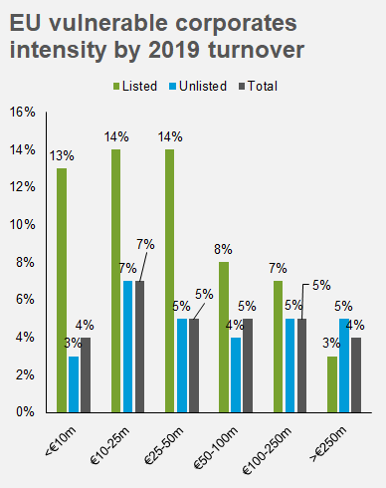
Sizing the problem
Cash buffers
Unsustainable debt
10% of EU companies have cash buffers to last 2 to 6 months at normal rates of expenditure.
EU corporate unsustainable debt levels could be around €324 billion, of which SMEs hold roughly 59%.
Equity need
Equity shortfall
We estimate €1 trillion damage to corporate equity need. This is towards the upper end of the EC’s estimated range, consistent with the second-wave scenario.
Given €400-550 billion equity available at the EU-level, we estimate €450-600 billion equity shortfall. The total amount of new equity issuance in 2020 amounted to only 9.3% of the €1 trillion equity need.

Slide 4
Barriers to recapitalisation
What is preventing corporates from seeking recapitalisation?
One Italian corporate that listed in June faced a valuation that was half of its expected EBITDA valuation multiple
Preference to first cut costs and restructure
Concern around ceding control
Perceived depressed valuations
Lack of awareness on hybrid alternatives despite vast European hybrid landscape
What is preventing investors from aiding corporate recapitalisation?
One interview noted that, in conjunction with low market rates, the stringent Solvency II regime has constrained insurers to in more equity investment
Fragmentation across EU member states leading to costly due diligence
Insufficient corporate governance by smaller corporates
Lack of tax incentives
Regulatory barriers to institutional investment in riskier corporates

Slide 5



Funding available to support recapitalisation
Private sources
Public sources
EU27 equity and hybrid issuance (€m)
Instrument | 2016-19 annual average | 2020
Listed common equity | 63,047 | 77,354
Private equity and venture capital | 17,367 | 16,418
Total equity issuance | 80,414 | 93,772
Preferred equity | 5 | 49
Profit participating shares and debt | N/A | N/A
Corporate subordinated debt | 18,039 | 24,864
Convertible bonds | 9,533 | 20,043
Payment-in-kind (PIK) bonds | 9,717 | 11,997
Total hybrid issuance | 37,294 | 56,953
€25 billion
directed at SMEs in debt,
quasi-equity or guarantees
€672.5 billion
RRF grant and loan support
€26 billion
grant support

Slide 6
Our recommendations
We have developed an 8-step solution roadmap, in which policymakers and the private sector each have a role to play.
1
2
3
4
Develop common recapitalisation instrument
Scale up existing EU or member state schemes
Develop public-private working groups
Develop public-private EU investment fund
COVID-19 preference share
Cash flow certainty with low fixed basis preferred dividend
Increasing profit-sharing element
Could appeal to institutional investors seeking debt-type risk profiles with better returns
Individual schemes lack necessary capacity to address recapitalisation across the EU
Opportunities to scale up the EIF’s European Guarantee Fund, InvestEU fund, AXA’s CAPZA and others
Replicate existing initiatives at member state level
National equity recapitalisation forums to design the scheme
Leverage intermediary due diligence and distribution networks to raise corporate awareness
Public sector to provide technical assistance to underdeveloped capital markets
Public sector support through matched funding or first-loss approach to mobilise private capital
Leveraging private networks to enable knowledge transfer across regions
Local execution and tailored to local operational and regulatory requirements

Slide 7
Our recommendations (ctd.)
5
6
7
8
Introduce additional tax and regulatory incentives
Lower the cost of equity issuance for corporates
Optimise state aid rules application and tie RRF funding to recapitalisation
Accelerate implementation of CMU and Banking Union
Aligning tax incentives of equity and debt through temporary capital gains rollover relief
Carefully calibrated temporary adjustment to regulatory capital and solvency requirements for insurers
Greater efficiencies and regulatory simplification in capital raising process
Relaxation of pre-emption rules
Subsidies or grants to corporates for cost of equity issuance in exchange for equity to reduce ‘sticker shock’
Broaden state aid eligibility criteria
Extend repayment periods or introduce tiered interest rates
Target restructure and recovery, rather than delaying the inevitable, e.g. through RRF eligibility
Identify structural or regulatory obstacles preventing banking sector from leveraging capacity
Develop (SME) pan-European exchanges
Progress Digital Single Market, Banking Union and common EU insolvency regime

